Slide 1




GUJARAT ARTS AND SCIENCE COLLEGE
HOMETOGO

Slide 2

WATERFALL MODEL

Slide 3





PROCESS DIAGRAM
Requirement
gathering
DESIGN
CODING
TESTING
DEPLOYMENT
MAINTANENCE

Slide 4
Phases in waterfall model :
Requiement Gathering
and analysis :
During this phase, all the relevant information is collected from the customer to develop a product as per their expectation.Business analyst and Project Manager set up a meeting with the customer to gather all the information like what the customer wants to build, who will be the end-user, what is the purpose of the product. Before building a product a core understanding or knowledge of the product is very important.
2. Design :
In the design phase, one or more designs are created to achieve the project result. Depending on the project subject, the design phase products include dioramas, flow-charts,etc.
3. Implementation :
Implementation/Coding starts once the developer gets the Design document. The Software design is translated into source code. All the components of the software are implemented in this phase.

Slide 5
4. Testing :
Testing starts once the coding is complete and the modules are released for testing. In this phase, the developed software is tested thoroughly and any defects found are assigned to developers to get them fixed.
Retesting, regression testing is done until the point at which the software is as per the customer’s expectation.
5. Deployment :
Once the product is tested, it is deployed in the production environment or first UAT (User Acceptance testing) is done depending on the customer expectation. If the customer finds the application as expected, then sign off is provided by the customer to go live.
6. Maintenance :
After the deployment of a product on the production environment, maintenance of the product. i.e. if any issue comes up and needs to be fixed or any enhancement is to be done is taken care by the developers.

Slide 6
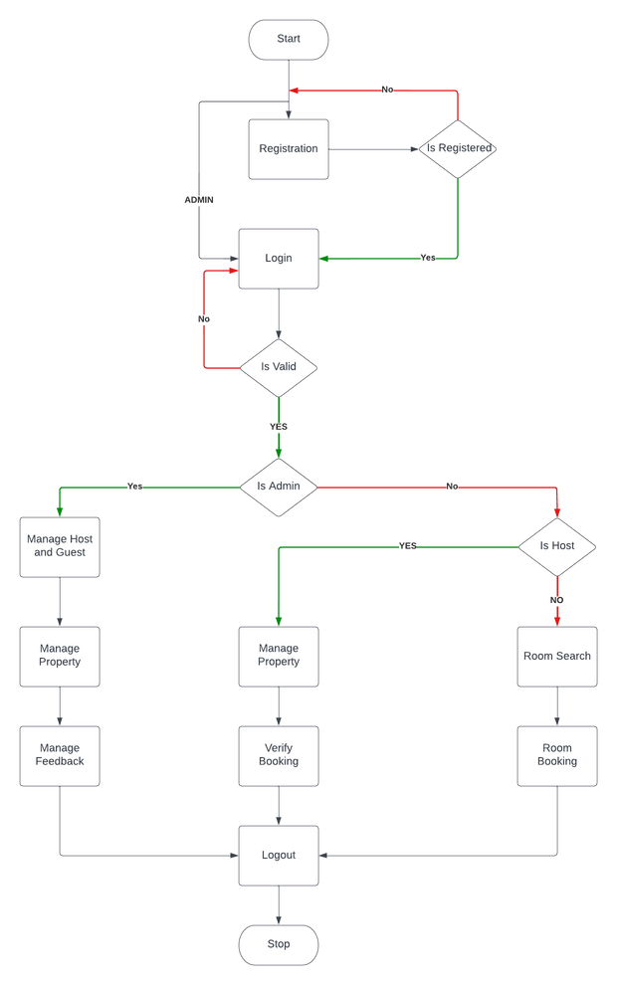
SYSTEM FLOW DIAGRAM

Slide 7
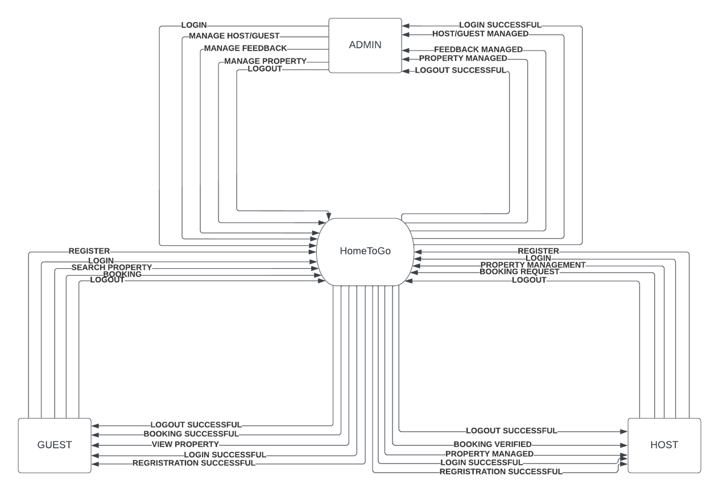
DATA FLOW DIAGRAM

Slide 8


Slide 9




Contents
Languages Used
Group Members
Introduction
Expected outcomes
Briefly elaboration.
Project Motive
Usefullness

Slide 10

Group Members
Aarti Kumari
Ansari Md Tanveer

Slide 11
Introduction
HomeToGo application will provide the Information adout Rooms/Flat/House/Buddy which is available for Rent/join you
This application will make easy to find the location of room/Flats/House, select no. rooms and other facts by the renter
It will make easy to upload the location,contact No, expected rent, No of rooms, facilities and other information about landlord/room-master
This application will be able to show the rooms/flats/houses/Buddy with in a particular area selected by user.

Slide 12
Project Motive
This service has become important factor in modern society hence the need to have a [rental house management application].
It is difficult to find house for the renter in a specific area.
It is also difficult to find the renter on time, for the landlord and property managers.
It is also difficult to find a good room Buddy on time, for the landlord and renter.

Slide 13
USEFULLNESS
Easy to find Room Buddy
Save Time and Resources
Easy to find Rooms Locations
Increase the Efficiency
Direct Communication
It will provide all nearby locations to renter and multiple renters to the landlord
Quick deal

Slide 14




HTML/CSS
For Frontend Design
Languages Used
PHP
For back end
My SQL
Text
For Database
Briefly elaborate on what you want to discuss.

Slide 15
Excepted Outcomes
Application will be a service which will connect Renters to Landlords and vice- versa.
it will save the physical hard work and invaluable time to find room/flat.
It will save Resources for Search the rooms/flats/houses.
Application will make easy to find rooms/flats for the renter and upload the location and other information by landlord/room-master.

Slide 16




HomeToGo

Slide 17
GUJARAT ARTS AND SCIENCE COLLEGE
HomeToGo

Slide 18



We are group 1 ...
AARTI KUMARI
TANVEER ANSARI
Our Guide is Mr Jatin Modi Sir.

Slide 19


1) Modules
2) Proposed System and
It's Drawbacks
3)Proposed System and
It's Features
Content
4) Hardware
Specifications
5)Software
Specifications

Slide 20


Modules
Admin
Host
Guest
Login
Manage User
Manage the System
Block User
REGISTER
Login
Add Housing details
& Description
Manage & Verify.
REGISTER
Login
Search
Book..

Slide 21



Current System and It's Drawbacks
Guest: 1) The physical hard work.
2) Difficult to find house.
3) Time and resources consuming.
4) You might feel Cooped Up.
5) Depending on the Destination ,It can get Expensive - Hotel
Host: 1) Difficult to find the renter.
2) Difficult to find a good room Buddy.
3) Can only reach few people.
Notes:
1. Physical hard work such as a person has to go and check every were wether available or not.
2. It is difficult to find house for the Guest in a specific area.
3. too much time waste in searching a good house or a place to live it becomes more difficult when you don't know about that place or you are new to it
4. if you are staying is a hotel room for a long time,it can start to feel a bit claustrophobic(Fear of Enclosed Spaces) . You might want to consider renting an apartment or a house if you are planning to live more than a week.
5. Hotels can be expensive if you are staying in a big city like Mumbai etc... If you are on a tight budget, it might be better to look for a cheaper accommodation option like HomeToGo!
------HOST--------
1) Difficult to find the renter on time
2) headache to find a good room buddy whith whome you can stay.
3. in an offline way you can only reach a very hand-full number of people.

Slide 22
Proposed System and It's Features
Features of the App :-
Users can use the app as host or guest .
Highly Attractive Graphical User Interface & User Friendly Features.
Features for Host:
Free unlimited room rental listings.
Advertise rooms in houses and apartment.
Room Owners can see guests Requests. .
Real time notifications for rental leads ( when they are registered ).
Advanced roommate filters to find roommate matches.
Notes:
Customizable Searches: Guests can search the hometogo database—not only by date and location, but by price, type of property, amenities, and the language of the host—and add keywords (”) to help new their search.

Slide 23



Features for guests :
Real-time notifications for new rooms for rent.
Room rental search by map or location
Advanced room rental filters .
Find room rentals in worldwide .
In budget room.

Slide 24
Hardware Specifications:
1) Admin:
Processor: 2.5 GHz processor speed
RAM: 8GB
Hard Disk: 512GB

Slide 25
Hardware Specifications:
2) Guest/Host:
Processor: 2.0 GHz processor speed
RAM: 2GB
Hard Disk: 206GB

Slide 26
Software Specifications:
1) Admin:
Browser: Any web Browser
Database server: My SQL
Operating System: Windows
Server : Xampp
Language : PHP,HTML,CSS,Bootstrap.

Slide 27
Software Specifications:
2) Host/Host:
Browser: Any web Browser.

Slide 28

Thank You!
Do you have any questions for me before we go?

